Slide 1
Clinical diagnostics in Non-Invasive Prenatal Testing Theresa Boomer, MS, LCGC, CG/MB(ASCP)^{CM}
Notes:
QB#8840

Slide 2

Disclosures and Disclaimers
I am an employee of and hold equity in Illumina, Inc.
The opinions expressed during this presentation are those of the speaker and may not represent the opinions of Illumina. Any uses of Illumina’s technology described in this presentation may be uses that have not been cleared or approved by the FDA, or any other applicable regulatory body
Non-invasive prenatal testing (NIPT) based on cell-free DNA analysis from maternal blood is a screening test; it is not diagnostic. Test results must not be used as the sole basis for diagnosis. Further confirmatory testing is necessary prior to making any irreversible pregnancy decision
The VeriSeq NIPT Solution v2 is an in vitro diagnostic test intended for use as a screening test for the detection of genome-wide fetal genetic anomalies from maternal peripheral whole blood specimens in pregnant women of at least 10 weeks gestation. VeriSeq NIPT Solution v2 uses whole genome sequencing to detect partial duplications and deletions for all autosomes and aneuploidy status for all chromosomes. The test offers an option to request the reporting of sex chromosome aneuploidy (SCA). This product must not be used as the sole basis for diagnosis or other pregnancy management decisions.
The VeriSeq NIPT Solution v2 includes: the Workflow for the VeriSeq NIPT Microlab STAR, the VeriSeq NIPT Sample Prep Kits, and the VeriSeq Onsite Server v2 with the VeriSeq NIPT Assay Software v2. The VeriSeq NIPT Solution v2 is intended to be used with a next generation sequencer.
Notes:
MLR approved: April 20, 2016
QB# 1808

Slide 3
Prenatal Testing Options
Notes:
CAP-Approved 20 April 2016
QB# 1808

Slide 4
Birth Defects Rates and causes in live births
97%
Normal
40–60%
3%
Defects
20–25%
10–15%
8–12%
2–10%
Adapted from Stevenson, RE and Hall, J. Human Malformations and Related Anomalies, 2nd ed. Oxford University Press, Oxford, 2006
Notes:
CAP-Approved QB# 5491, Approved December 2017
General overview of rates of birth defects and etiologies
>95% of babies are born healthy, without birth defects
Of the 3-4% of babies born with birth defects:
10-15% are chromosome abnormalities (aneuploidy)
8-12% are due to exposures
2-10% are single-gene disorders
Dwarfism or muscular dystrophy
20-25% are multi-factorial (due to a combination of genes and environment)
cleft lip / palate
40-60% are unknown

Slide 5
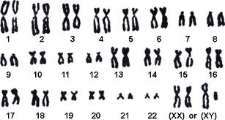
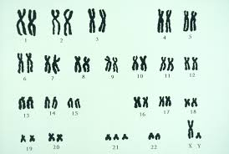
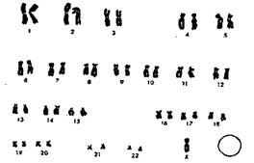
Aneuploidy
Loss or Gain of Chromosomes
(Euploid) Normal
Down Syndrome -Trisomy 21 (Extra chromosome)
Turner Syndrome Monosomy X (less chromosome)
Notes:
46 chromosome, 2 sex chromosomes
Any extra or missing risk for developmental problems
LD
MR
physical abnormalities

Slide 6
Prenatal Prevalence Of reported chromosomal abnormalities
53%
Major fetal aneuploidies
T21
T18
T13
16%
13%
45,X
8%
5%
5%
Data adapted from Wellesley, D, et al., Rare chromosome abnormalities, prevalence and prenatal diagnosis rates from population-based congenital anomaly registers in Europe. Eur J of Hum Gen 11 January 2012.
Notes:
CAP-Approved QB# 5491, Approved December 2017
Other rare – traditionally difficult to screen, moving in that direction

Slide 7
Conventional Prenatal Screening Options Detection rates for Trisomy 21
 |  |  |  |  | Detection rate (%)
1st Trimester: | NT Ultrasound |  |  |  | 64–70
1st Trimester: | 1st Trimester blood screen |  | NT Ultrasound |  | 82–87
2nd Trimester: | Triple screen |  |  |  | 69
2nd Trimester: | Quadruple screen |  |  |  | 81
Integrated screen: | 1st Trimester blood screen | NT Ultrasound |  | 2nd Trimester blood screen | 94–96
Serum integrated: | 1st Trimester blood screen |  | 2nd Trimester blood screen |  | 85–88
Sequential screen: | 1st Trimester blood screen | NT Ultrasound |  | 2nd Trimester blood screen | 95
 | False positive rate: |  |  |  | ~5%
American College of Obstetricians and Gynecologists. Screening for fetal aneuploidy. Practice Bulletin No. 163. Obstet Gynecol. 2016; 127(5):e123-37.
Notes:
CAP-Approved QB# 5491, Approved December 2017
Screening test:
simple
affordable
widely available
early detection
subset who benefit most from more testing
Mammogram, pap smear, PSA blood test, colonoscopy, A1C diabetes
Daughter Quad
Son Penta

Slide 8
2nd Trimester Quadruple Serum screening
Distribution curve for euploid pregnancies
Distribution curve for Trisomy 21 pregnancies
15% False Negative
8.5% False Positive
Area of overlap
1/300 risk cut-off
Distribution curves not to scale.
Malone FD, Canick JA, Ball RH, et al. First-trimester or second-trimester screening, or both, for Down's syndrome. N Engl J Med. 2005;353(19):2001–2011.
Notes:
CAP-Approved QB# 5491, Approved December 2017
Every screening test

Slide 9
Factors Affecting Analyte Levels in Traditional Screening
Gestational age¹
Maternal Weight^{2,3}
First trimester:
Human chorionic gonadotropin (hCG) levels fall rapidly; Pregnancy-associated plasma protein A (PAPP-A) increases rapidly
Second trimester:
Alpha-feto protein (AFP) and unconjugated estriol increase; hCG declines; Inhibin-A remains stable
Errors in estimation can lead to false positive or false negative results
Inversely correlated to analyte levels due to the larger blood volume of heavier women
Racial/Ethnic background⁴
Diabetes Mellitus⁵
African American women tend to have higher AFP, PAPP-A, and hCG levels and lower Inhibin-A levels than Caucasian women
Women with insulin dependent diabetes mellitus have lower levels of AFP and unconjugated estriol compared to pregnant women without diabetes
American College of Medical Genetics. Standards and Guidelines for Clinical Genetics Laboratories. Second Edition, 1999
Lambert-Messerlian G, Palomaki GE, and Canick JA. Adjustment of serum markers in first trimester screening. J Med Screen. 2009;16(2):102-3.
Wald NJ, Kennard A, Hackshaw A, and McGuire A. Antenatal screening for Down's syndrome. J Med Screen. 1997;4(4):181-246. Review. Erratum in: J Med Screen 1998;5(2):110. J Med Screen 1998;5(3):166.
Spencer K, Heath V, El-Sheikhah A, Ong CY, and Nicolaides KH. Ethnicity and the need for correction of biochemical and ultrasound markers of chromosomal anomalies in the first trimester: a study of Oriental, Asian and Afro-Caribbean populations. Prenat Diagn. 2005;25(5):365-9.
Baumgarten A and Robinson J. Prospective study of an inverse relationship between maternal glycosylated hemoglobin and serum alpha-fetoprotein concentrations in pregnant women with diabetes. Am J Obstet Gynecol. 1988;159(1):77-81.
Notes:
CAP-Approved QB# 5491, Approved December 2017
finicky

Slide 10
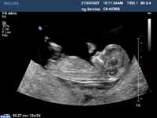
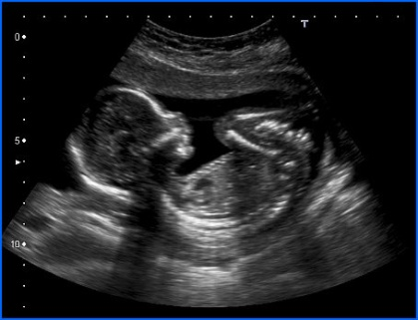
Current Paradigm of Prenatal Screening & Diagnostic Testing
First day of Last Menstrual Period
13 wks
27 wks
40 wks
1st Trimester
2nd Trimester
3rd Trimester
NIPT
1st Trimester screen
(serum + ultrasound)
2nd Trimester screen
(serum)
Chorionic villus sampling
Amniocentesis
Notes:
MRL Approved 18Oct16 QB# 3062
CVS and amnio = gold standard, truth, was reserved for only high risk
Validating a screening assay, this is point of comparison

Slide 11
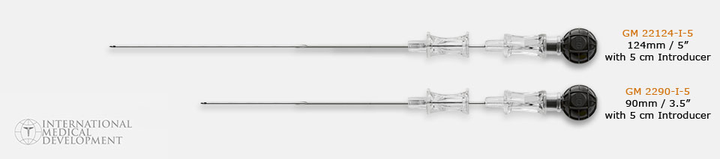
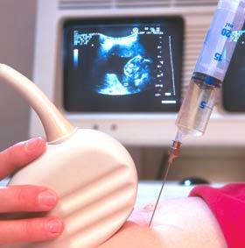
Diagnostic Testing Options
Trimester–Test | Sensitivity | Specificity | Fetal Loss Rate
1st–CVS | 99.25%¹ | 98.65%¹ | 1.1%³
2nd–Amniocentesis | 99.4%² | 99.5%² | 0.4%³
Even the gold standard is not 100% sensitive and specific. Additionally, there are risks of maternal infection, bleeding, fluid leakage, and fetal loss.
Hahnemann JM, Vejerslev LO. Accuracy of cytogenetic findings on chorionic villus sampling (CVS)—diagnostic consequences of CVS mosaicism and non-mosaic discrepancy in centres contributing to EUCROMIC 1986-1992. Prenat Diagn. 1997;17(9):801-820.
Mid-trimester amniocentesis for prenatal diagnosis. Safety and accuracy. JAMA. 1976; 236(13): 1471-1476.
Enzensberger C, Pulvermacher C, Degenhardt J, et al. Fetal loss rate and associated risk factors after amniocentesis, chorionic villus sampling and fetal blood sampling. Ultraschall Med. 2012;33(7):E75-9.
Notes:
MRL Approved 18Oct16 QB# 3062
Even the gold standard isn’t currently at 100% sens/spec.
Validation comparison
Any pos screen should proceed to additional, confirmatory testing

Slide 12
Evolution of Prenatal Testing
Diagnostic & Screening Test Options
1966
1980s
1980s
1990s
2011
Amnio
Amniocentesis for fetal chromosomes
Serum Screen
For neural tube defects & aneuploidy (T21, T18)
CVS
Chorionic Villus Sampling for placental/fetal chromosomes
NT
Nuchal Translucency for aneuploidy
NIPT
Noninvasive Prenatal Testing for fetal chromosomes & Prenatal Microarrays

Slide 13
Non-Invasive Prenatal Testing (NIPT)
Technology Overview
Notes:
CAP-Approved QB# 5491, Approved December 2017

Slide 14
Noninvasive Prenatal Testing (NIPT)
Objectives of NIPT
Reduce exposure of fetus to risk
Reduce false positives
Testing that can easily be offered to pregnant women
Enable a high detection rate
Notes:
MRL Approved 18Oct16 QB# 3062
2011
25 calls
Initially OOP, then only for high risk, now mixed
Soft launch, 20 centers
25 calls
Patients demanded of providers

Slide 15
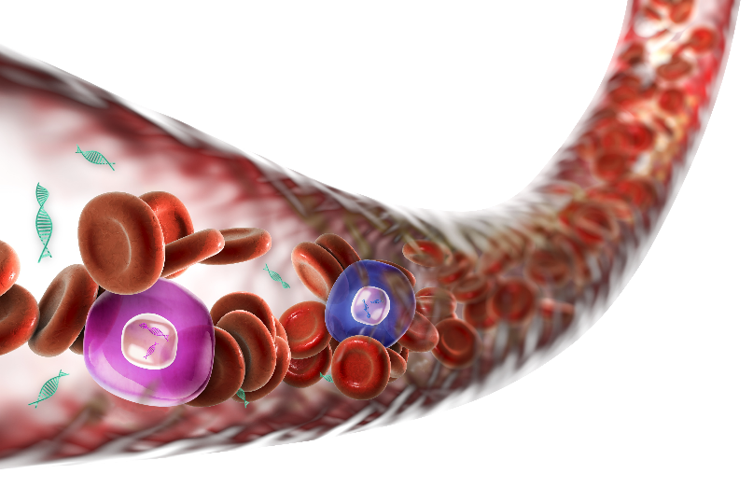
Cell-Free DNA (cfDNA) in Maternal Blood An ideal analyte for aneuploidy testing
Maternal blood contains both maternal and fetal cfDNA
2–20% of total cfDNA in maternal blood is placental (cytotrophoblastic)^{1,2}
Released into bloodstream through apoptosis (cell death)
Detected after 7+ weeks gestation and undetectable within hours postpartum²
Barrett, A, Zimmerman BG, Wang D, Holloway A, Chitty L. Implementing prenatal diagnosis based on cell-free fetal DNA: Accurate identification of factors affecting fetal DNA yield. PLoS One. 2011;6(10):e25202..
Nigam A, Saxena P, Prakash A, Acharya A.Detection of fetal nucleic acid in maternal plasma: A novel noninvasive prenatal diagnostic technique. J Interntl Med Sci Acad.2012; 25(3): 119-120.
Notes:
CAP-Approved QB# 5491, Approved December 2017
Generally (Placental genome ≈ Fetal genome)
Short DNA fragments (150–200bp) are released into bloodstream

Slide 16
Method of Analysis for Illumina NIPT
1. Extract and Prepare cfDNA
2. Whole-Genome Sequencing
3. Alignment
4. Counting
Not to scale
Fetal cfDNA
(20%)
10% more Chr21 cfDNA in T21
Maternal cfDNA
VS
.......
Chromosome:
1
2
21
Trisomy 21
Notes:
MRL Approved 18July2017 QB#4676
Different methods, whole genome sequencings = counting method

Slide 17
Evidence for NIPT Performance
Updated meta-analysis
Review of the clinical validation and implementation studies for cfDNA screening for fetal aneuploidies
35 publications on NIPT for detection of aneuploidies between 2011–2016*
 | Pooled Weighted Detection Rate (%) | 95% Confidence Interval | False Positive Rate (%) | 95% CI
Singleton Pregnancies
Trisomy 21 | 99.7 | 99.1-99.9 | 0.04 | 0.02-0.07
Trisomy 18 | 97.9 | 94.9-99.1 | 0.04 | 0.03-0.07
Trisomy 13 | 99.0 | 65.8-100 | 0.04 | 0.02-0.07
Monosomy X | 95.8 | 70.3-99.5 | 0.14 | 0.05-0.38
Other sex aneuploidies** | 100.0 | 83.6-100 | 0.004 | 0-0.08
Twin Pregnancies
Trisomy 21*** | 100.0 | 95.2-100 | 0 | 0-0.003
* Includes papers describing three different sequencing methodologies used for NIPT: massively parallel shotgun sequencing (MPSS), also known as whole-genome sequencing (WGS); chromosome-specific sequencing (CSS, also known as targeted sequencing); single-nucleotide polymorphism (SNP) sequencing. Note: Samples that resulted in a test failure were excluded from the analysis.
** The authors concluded that the number of reported cases of sex chromosome abnormalities is too small for accurate assessment of performance in screening.
*** The authors concluded that the performance of screening for trisomy 21 in twin pregnancies is encouraging, but the number of cases reported is small.
Gil MM, Accurti V, Santacruz B, Plana MN, Nicolaides KH. Analysis of cell-free DNA in maternal blood in screening for fetal aneuploidies: updated meta-analysis. Ultrasound Obstet Gynecol. 2017 Apr 11. doi: 10.1002/uog.17484. [Epub ahead of print].
Notes:
QB#4591 Approved June 2017
Meta-analysis – included both WGS and targeted based methods

Slide 18
PPV of NIPT and Serum Screening Across maternal ages
1. Snijders RJ, Sebire NJ, and Nicolaides KH. Maternal age and gestational age-specific risk for chromosomal defects. Fetal Diagn Ther. 1995 Nov-Dec;10(6):356-67.
2. Gil MM, Accurti V, Santacruz B, Plana MN, Nicolaides KH. Analysis of cell-free DNA in maternal blood in screening for fetal aneuploidies: updated meta-analysis. Ultrasound Obstet Gynecol. 2017 Apr 11. doi: 10.1002/uog.17484.
3. Santorum M, Wright D, Syngelaki A, Karagioti N, and Nicolaides KH. Accuracy of first trimester combined test in screening for trisomies 21, 18, and 13. Ultrasound Obstet Gynecol. 2017 Jun;49(6):714-720.
4. Cuckle H, Benn P, and Wright D. Down Syndrome Screening in the First and/or Second Trimester: Model Predicted Performance Using Meta-Analysis Parameters. Semin Perinatol. 2005 Aug;29(4):252-7.
Notes:
Why dx confirmatory testing always necessary
One argument that continues to be made for traditional screening over screening via NIPT in the average-risk population is the lower positive predictive value for lower risk women. Positive predictive value, or PPV, is the chance that a screen positive result is a true positive. The PPV is affected by both the false positive rate of a test, as well as the prevalence of a condition. This graph is very striking and shows that because the false positive rate of NIPT is so much better than any traditional screening method, the PPV is significantly higher for NIPT along the maternal age continuum even in younger women where the prevalence of DS is lower.
When considering what a lower FPR and a higher PPV means from a clinical practice standpoint, it means that less women are referred for invasive testing. While invasive testing is necessary to confirm abnormal screen results, improving accuracy of screening means that less women with unaffected pregnancies will receive abnormal screen results and be referred for invasive testing. The potential cost savings for reducing the number of needed confirmatory diagnostic invasive tests are substantial.

Slide 19
Projected PPVs by Maternal Age PPV directly related to prevalence of the condition
Taneja PA, Snyder HL, de Feo E, et al. Noninvasive prenatal testing in the general obstetric population: clinical performance and counseling considerations in over 85 000 cases. Prenat Diagn. 2016; 36(3):237-243.
PPV calculated using sensitivities and specificites based on observed clinical outcomes data
Estimated prevalences at 10 weeks of gestation derived from: Gardner RJM, Sutherland GR, Schaffer LG. Chromosome Abnormalities and Genetic Counseling 4th ed. New York, NY: Oxford University Press; 2012.
Notes:
CAP-Approved QB# 5491, Approved December 2017
Increase with maternal age
Decrease with GA
Difficult concept for clinicians to grasp
Talking point:
In the previous slide, we showed the PPV for our study cohort using the information on true and false positives reported to the lab.
But at an individual level, PPV calculation requires knowledge of the a priori risk for an individual.
This is a modeled plot showing that as the prevalence increases, PPV improves
This is fundamentally and directionally correct that, even with the same sensitivity and specificity, prevalence of a condition will significantly impacts the PPV
Additional points
In this figure, the dashed lines indicate the estimated prevalence at 10 weeks of gestation for trisomy 21, 18, and 13. The columns indicated the predicted PPV based on a priori risk determined by maternal age alone
The use of validation metrics in place of clinical metrics would result in similar PPVs, with the same trend for increasing PPVs with increasing incidence.
When counseling patients, clinical consideration should be given to the presence of other indications (eg, ultrasound findings) that may elevate a patient’s a priori risk, and therefore PPV, over that determined by maternal age alone. Although the PPV for average-risk women is lower than for high-risk women, it is important for clinicians to understand that the PPV for NIPS is higher than with traditional pregnancy screening options, regardless of maternal age or a priori risk.
Notes for Calculation of sensitivities and specificities from clinical data (with incomplete outcomes):
Assumed all FN had been reported
Adjusted total cohort size based on the proportion of positive cases with outcomes. Eg. For T21
1,356 cases were reported as positive and 83,942 were reported as negative
Cytogenetic confirmation revealed 443 TP, 75 FP, and 6 FN
The proportion of positive cases with outcomes was 38.2% = (443 + 75) / 1,356
Adjusted FN number was 2 = 6 x 38.2%
Adjusted TN was 32,064 = (83,942 - 6) x 38.2%
Observed sensitivity was 99.6% = 443 / (443 + 2)
Observed specificity was 99.8% = 32,064 / (32,064 + 75)
Differences between sensitivity and specificity in table in the slide and text explanation here are due to rounding in the text explanation (the notes given here)

Slide 20
NIPT Statistical Tools

Slide 21
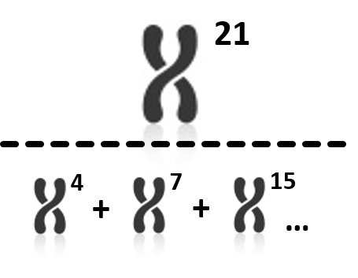
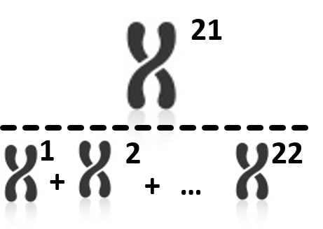
Different Statistical Approaches
NCV Method
Z-score Method
Cell-free DNA Sequenced and Aligned to Genome
(custom Reference Chr(s))
All Chromosomes
NCV Method | Z-score Method
High Precision, removes variation | Sample to sample variability
Maximizes Dynamic Range | Reduces Dynamic Range
GC Correction
NCV Result
Z-score Result
21
Palomaki GE, Kloza EM, Lambert-Messerlian GM, et al. DNA sequencing of maternal plasma to detect Down syndrome: An international clinical validation study Genet Med 2011;13:913–920.
Palomaki GE, Deciu C, Kloza EM, et al. DN A sequencing of maternal plasma reliably identifies trisomy 18 and trisomy 13 as well as Down syndrome: an international collaborative study. Genet Med 2012:14(3):296–305.
Bianchi DW, Platt LD, Goldberg JD, et al. Genome-Wide Fetal Aneuploidy Detection by Maternal Plasma DNA Sequencing. Obstet Gynecol 2012;119:890–901.
Notes:
Reference set makes difference
Optimal conditions ok, reality is rarely optimal
GC rich
Dynamic range is the separation between aneuploidy samples and euploid samples,
Optimal set of chromosomes, (those that show the least variation from test chromosome under sequencing conditions) are used as the denominator.
The NCV method is different from other methods, in that its ratio is optimized to include only chromosomes that behave similarly to the test chromosome under sequencing. By contrast, another test uses the standard z-score method (Sequenom’s MaterniT21 test), which compares the number of counts on a test chromosome to the total number of counts across all chromosomes. This includes chromosomes that behave very differently from the test chromosome, and as such introduces a large amount of noise to the result. This requires after-the-fact correction factors such as GC correction to reduce noise. The NCV method does not require these correction factors, and provides a high precision result that reduces sample to sample variability and maximizes the dynamic range in your data.
Note for the nerdy: Actually, our NCV result IS technically a z-score, just a more optimized version of a z-score. The term ‘z-score’ generally refers to a measure of number of standard deviations away from the average value of a reference set of euploid samples (a.k.a. training set). So an NCV of 4 means that the computed NCV ratio for that sample is 4 standard deviations away from the average value in a reference set of euploid samples.
Calculates the ratio of sequences originating from a chromosome of interest to sequences originating from all chromosomes to determine if there is an increased contribution from the chromosome of interest

Slide 22
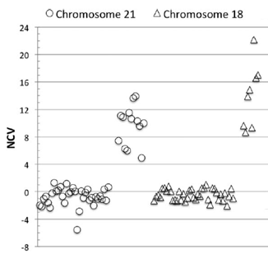
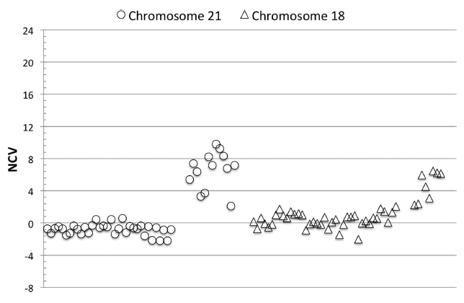
Technical Methods Comparison
Analysis using the same dataset demonstrated diminished separation between affected and unaffected samples and decreased detection rate with uncorrected Z-score method
NCV Method
Z-score Method
Sehnert, et al, Clin Chem, Jul;57(7):1042-9.
Notes:
NCV reduces sample to sample variation and Maximizes dynamic range

Slide 23


Detection of Aneuploidy Trisomy 21
Normal
Trisomy 21
chr8
chr21
Mom (90%)
Fetus (10%)
Mom (90%)
Fetus (10%)
 | # of mapped read on Chr21 | # of mapped read on Chr8
Total | 1000 | 4000
Mom | 900 | 3600
Fetus | 100 | 400
 | # of mapped read on Chr21 | # of mapped read on Chr8
Total | 1050 | 4000
Mom | 900 | 3600
Fetus | 150 | 400
Total read# of Chr21
1000
Total read# of Chr21
1050
=
=
0.25
=
=
0.2625
Total read# of Chr8
4000
Total read# of Chr8
4000
Notes:
Small increase relative to FF, LOR

Slide 24

Paired-End Sequencing Combine Counting and Fragment Size
Using counting statistics, determine if more than expected number of reads mapped to the target chromosome
Using fragment size statistics, determine if fraction of short fragments was higher on the target chromosome
Combine counts and frag size statistics for final scoring
Test Chromosome
Normalizing Chromosome(s)
Short fragments
Long fragments
*Counting statistic compared after within-sample normalization

Slide 25
Expanded Options and Future directions

Slide 26
NIPT Progression
High speed evolution
2011-2012
2012
2013
2013
2015
2015
2017
T21, T13, T18
Sex
SCA
Microdeletions
RAAs
CNVs
Single Gene
Limited Availability
Notes:
Validate something super rare
In silico
Multiple hypothetical monosomic, disomic, and trisomic fetal genotypes are created in silico and compared to what the sequencing data is expected to look like for each scenario and the hypothesis with the maximum likelihood is determined

Slide 27
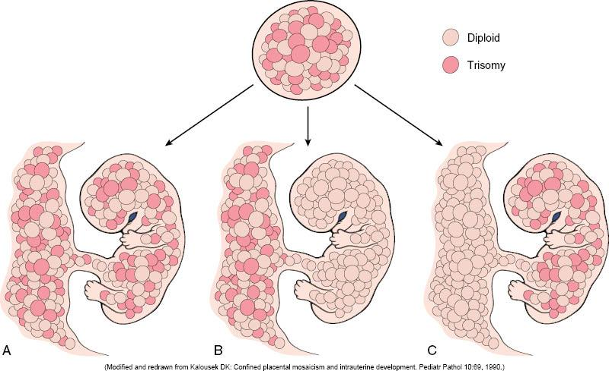
Mosaicism A static biological limitation
Generalized
mosaicism
Confined placental mosaicism
Fetal
mosaicism
Kumar, et al. Robbins & Cotran Pathologic Basis of Disease, 7th Edition. Philadelphia, PA: W.B. Saunders Company; 2004.
Notes:
CAP-Approved QB# 5491, Approved December 2017

Slide 28
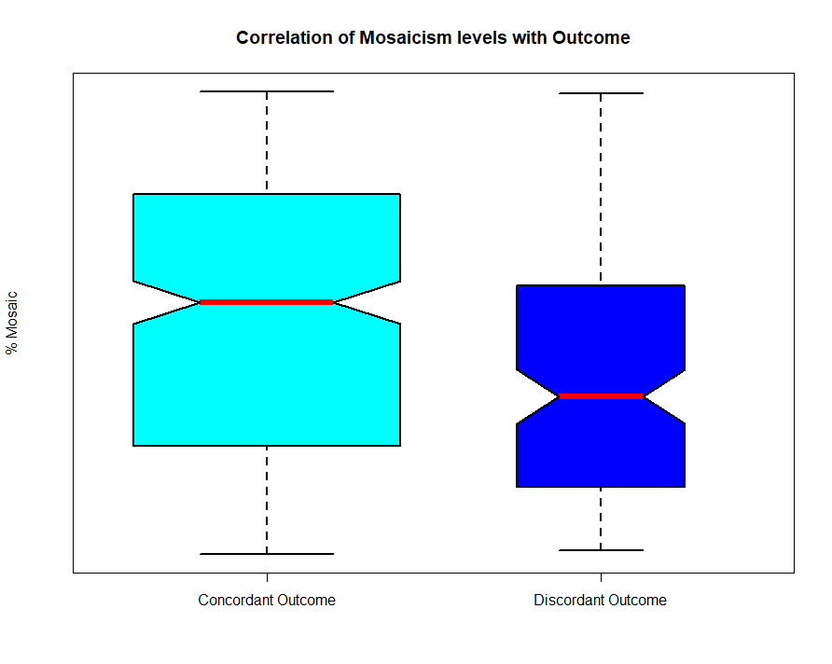
Comparison of Mosaicism ~ Outcome
p <0.001
p =0.117
0.46
0.36
p <0.001
Boomer, T et al. Mosaicism Ratio in cfDNA Prenatal Screening: An invaluable tool for clinical management guidance.
Poster & oral presentation @ ACMG 2019 Annual Meeting, Seattle, WA.

Slide 29
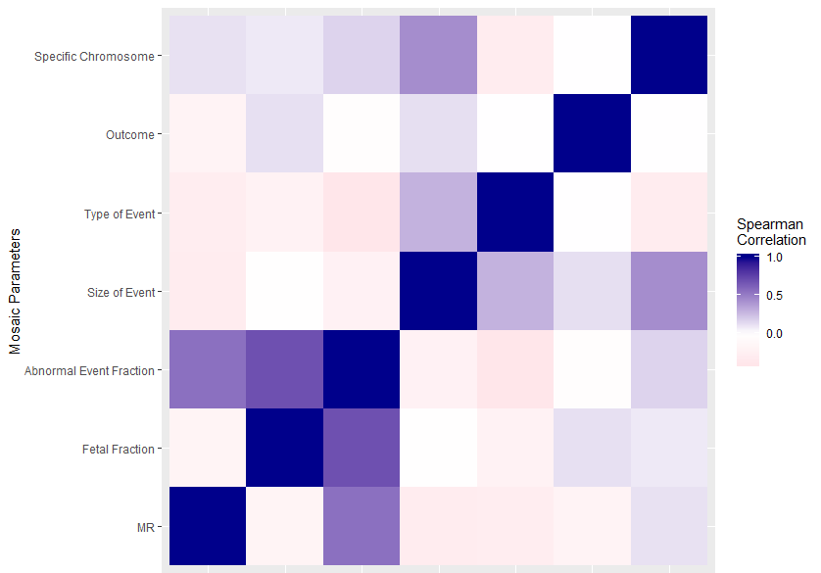
Mosaicism Correlation Heatmap
p <0.001
p =0.117
% Mosaic
% Mosaic
Abnormal Event Fraction
Type of Event
Specific Chromosome
Fetal Fraction
Site of Event
Outcome
Boomer, T et al. Mosaicism Ratio in cfDNA Prenatal Screening: An invaluable tool for clinical management guidance.
Poster & oral presentation @ ACMG 2019 Annual Meeting, Seattle, WA.

Slide 30
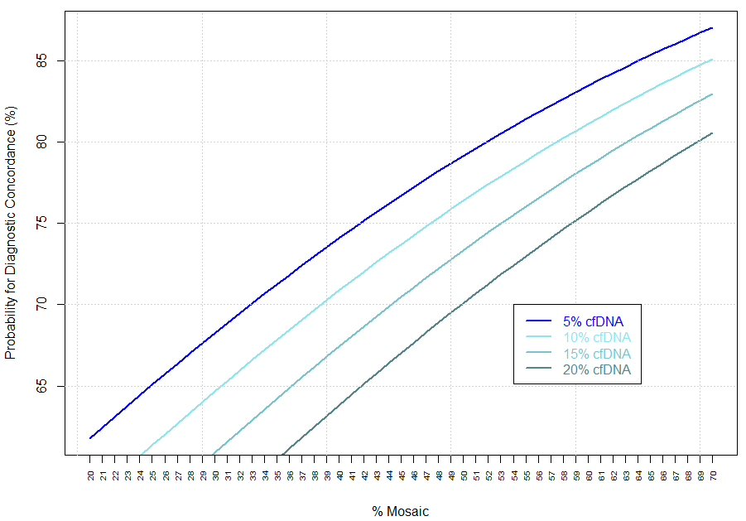
‘Positive Predictive’ Logistic Regression Model
logit = ln[p/(1-p)] = -a - β₁(Ratio of Mosaicism) + β₂ (cfDNA.FF)
p (aka ‘probability for discordance’) = e^{logit} /(1+ (e^{logit}))
PPV (aka ‘probability for concordance’) = 1-p
Boomer, T et al. Mosaicism Ratio in cfDNA Prenatal Screening: An invaluable tool for clinical management guidance.
Poster & oral presentation @ ACMG 2019 Annual Meeting, Seattle, WA.

Slide 31
Summary
01
Transformed prenatal testing
NIPT
Non-Invasive Prenatal Testing
02
Unpredicted rapid adoption & development of an LDT
03
Clinicians faced with learning / adopting statistical tools
04
Future directions will heavily rely on advanced statistical analyses and modeling

